Slide 1
GRADE 7 ACCELERATED · UNIT 2 · LESSON 3
Cube Values
MA.8.AR.2.3
I can evaluate a cube root and find every real solution of x³ = q.
Yesterday: two answers, one answer, or none.
Today: always exactly one. The reason is the count of negative factors.
Grade 7 Accelerated · Unit 2 · Lesson 3 — Cube Values
1

Slide 2
Warm-Up
On your own. Four minutes.
Same and different
A square with area 64 has a side of 8. A cube with volume 64 has an edge of 4.
1.
What is the same about the two situations?
2.
What is different?
3.
Why do the same 64 give two different answers?
Grade 7 Accelerated · Unit 2 · Lesson 3 — Cube Values
2

Slide 3
Notes
I. Cubing means multiplying a number by itself three times
A.
cube (a number) — to multiply the number by itself three times
B.
4 cubed = 4³ = 4 × 4 × 4 = 64.
C.
It is NOT 4 × 3. The small 3 counts appearances, the same as the small 2 did.
D.
The volume of a cube is V = s × s × s = s³.
Grade 7 Accelerated · Unit 2 · Lesson 3 — Cube Values
3

Slide 4
Notes
II. The perfect cubes, and their negatives
A.
perfect cube — a number you get by cubing an integer
B.
1, 8, 27, 64, 125
C.
and their negatives: −1, −8, −27, −64, −125
D.
Five numbers and their opposites. Worth as many points as yesterday's longer list.
Grade 7 Accelerated · Unit 2 · Lesson 3 — Cube Values
4

Slide 5
Notes
III. A negative number has a cube root
A.
The index is written this time. ∛q means the cube root of q.
B.
∛27 = 3, because 3 × 3 × 3 = 27.
C.
∛−27 = −3, because (−3) × (−3) × (−3) = −27.
D.
Three negative factors give a NEGATIVE product. Two would have given a positive.
Grade 7 Accelerated · Unit 2 · Lesson 3 — Cube Values
5

Slide 6
Notes
IV. Solving x³ = q — always exactly one
If q is …
How many solutions
Example
POSITIVE
one, and it is positive
x³ = 8 gives x = 2
ZERO
one, and it is 0
x³ = 0 gives x = 0
NEGATIVE
one, and it is negative
x³ = −8 gives x = −2
Grade 7 Accelerated · Unit 2 · Lesson 3 — Cube Values
6

Slide 7
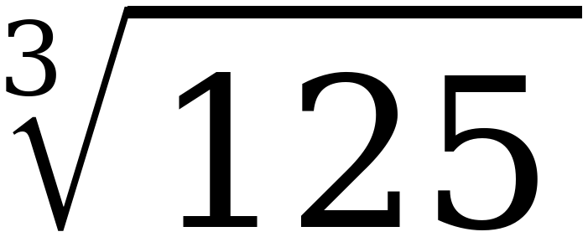
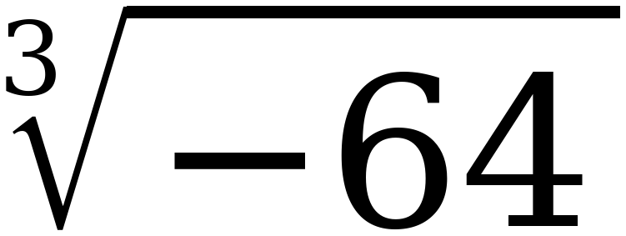
Example 1
Two cube roots. Answer out loud.
Which of the two will have a negative answer, and how do you know before you compute it?
Grade 7 Accelerated · Unit 2 · Lesson 3 — Cube Values
7

Slide 8
Example 1
Both, worked.
= 5 because 5 × 5 × 5 = 125
= −4 because (−4) × (−4) × (−4) = −64
Grade 7 Accelerated · Unit 2 · Lesson 3 — Cube Values
8

Slide 9
Example 1
Why the second one is negative.
(−4) × (−4) × (−4)
the first two cancel the third one stays
Grade 7 Accelerated · Unit 2 · Lesson 3 — Cube Values
9

Slide 10
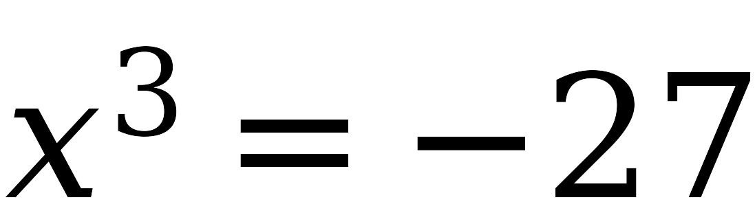
Example 2
Solve it. Whiteboards.
How many solutions, and what are they?
Grade 7 Accelerated · Unit 2 · Lesson 3 — Cube Values
10

Slide 11
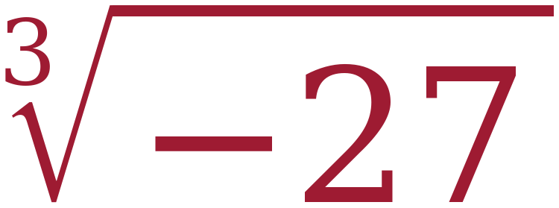
Example 2
The solution.
x =
= −3
Check: (−3) × (−3) × (−3) = −27 ✓
Grade 7 Accelerated · Unit 2 · Lesson 3 — Cube Values
11

Slide 12
Example 2
And why there is no second one.
Try x = 3: 3 × 3 × 3 = 27
27 is not −27. ✗
Grade 7 Accelerated · Unit 2 · Lesson 3 — Cube Values
12

Slide 13
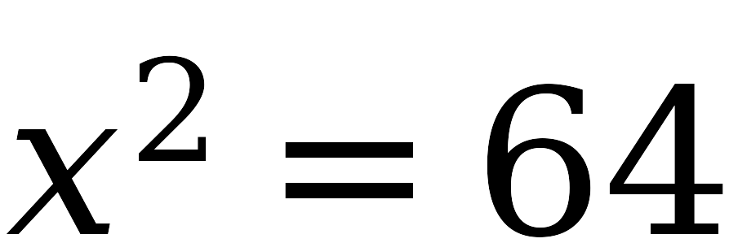
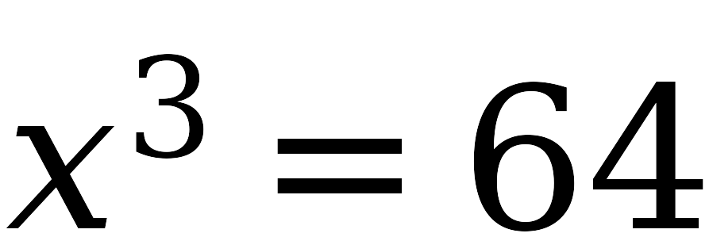
Example 3
Same 64. One solution or two?
Take a vote before anybody writes anything.
Grade 7 Accelerated · Unit 2 · Lesson 3 — Cube Values
13

Slide 14
Example 3
Try both signs on each.
x² = 64
x³ = 64
8 × 8 = 64 ✓
4 × 4 × 4 = 64 ✓
(−8) × (−8) = 64 ✓
(−4) × (−4) × (−4) = −64 ✗
Grade 7 Accelerated · Unit 2 · Lesson 3 — Cube Values
14

Slide 15
Example 3
So the counts differ.
x² = 64
x³ = 64
TWO solutions, x = ±8
ONE solution, x = 4
Grade 7 Accelerated · Unit 2 · Lesson 3 — Cube Values
15

Slide 16
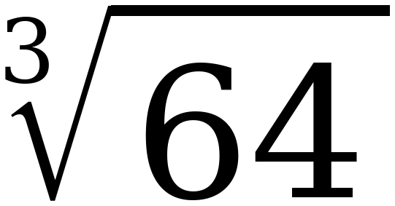
Whiteboards · Question 1 of 9
Boards up on three.
Answer it.
A number, or a sentence. Read the index first.
Grade 7 Accelerated · Unit 2 · Lesson 3 — Cube Values
16

Slide 17
Whiteboards · Question 1 of 9
Answer.
4 × 4 × 4 = 64
Answer: 4
Grade 7 Accelerated · Unit 2 · Lesson 3 — Cube Values
17

Slide 18
Whiteboards · Question 2 of 9
Boards up on three.
Answer it.
A number, or a sentence. Read the index first.
Grade 7 Accelerated · Unit 2 · Lesson 3 — Cube Values
18

Slide 19
Whiteboards · Question 2 of 9
Answer.
(−4) × (−4) × (−4) = −64
Answer: −4
Grade 7 Accelerated · Unit 2 · Lesson 3 — Cube Values
19

Slide 20
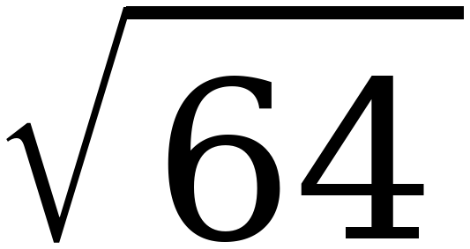
Whiteboards · Question 3 of 9
Boards up on three.
Answer it.
A number, or a sentence. Read the index first.
Grade 7 Accelerated · Unit 2 · Lesson 3 — Cube Values
20

Slide 21
Whiteboards · Question 3 of 9
Answer.
8 × 8 = 64
Answer: 8
Grade 7 Accelerated · Unit 2 · Lesson 3 — Cube Values
21

Slide 22
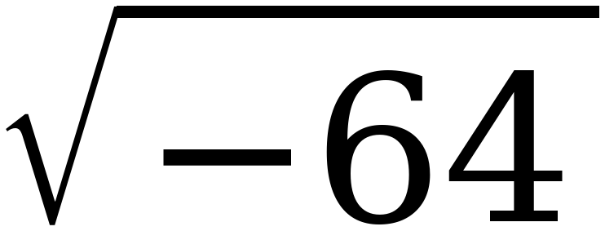
Whiteboards · Question 4 of 9
Boards up on three.
Answer it.
A number, or a sentence. Read the index first.
Grade 7 Accelerated · Unit 2 · Lesson 3 — Cube Values
22

Slide 23
Whiteboards · Question 4 of 9
Answer.
nothing real squares to a negative
Answer: no real value
Grade 7 Accelerated · Unit 2 · Lesson 3 — Cube Values
23

Slide 24
Whiteboards · Question 5 of 9
Boards up on three.
Answer it.
A number, or a sentence. Read the index first.
Grade 7 Accelerated · Unit 2 · Lesson 3 — Cube Values
24

Slide 25
Whiteboards · Question 5 of 9
Answer.
only 4 works
Answer: x = 4
Grade 7 Accelerated · Unit 2 · Lesson 3 — Cube Values
25

Slide 26
Whiteboards · Question 6 of 9
Boards up on three.
Answer it.
A number, or a sentence. Read the index first.
Grade 7 Accelerated · Unit 2 · Lesson 3 — Cube Values
26

Slide 27
Whiteboards · Question 6 of 9
Answer.
8 and −8 both work
Answer: x = ±8
Grade 7 Accelerated · Unit 2 · Lesson 3 — Cube Values
27

Slide 28
Whiteboards · Question 7 of 9
Boards up on three.
A cube-shaped box holds 125 cubic inches. How long is one edge?
Give the edge, with its unit.
A number, or a sentence. Read the index first.
Grade 7 Accelerated · Unit 2 · Lesson 3 — Cube Values
28

Slide 29
Whiteboards · Question 7 of 9
Answer.
A cube-shaped box holds 125 cubic inches. How long is one edge?
5 × 5 × 5 = 125
Answer: 5 inches
Grade 7 Accelerated · Unit 2 · Lesson 3 — Cube Values
29

Slide 30
Whiteboards · Question 8 of 9
Boards up on three.
Answer it.
A number, or a sentence. Read the index first.
Grade 7 Accelerated · Unit 2 · Lesson 3 — Cube Values
30

Slide 31
Whiteboards · Question 8 of 9
Answer.
(−3) × (−3) × (−3) = −27
Answer: x = −3
Grade 7 Accelerated · Unit 2 · Lesson 3 — Cube Values
31

Slide 32
Whiteboards · Question 9 of 9
Take your time. Boards up when you have written it.
Priya says ∛−64 has no real value, because you cannot take the root of a negative number. Is she right?
Write your answer in sentences.
This one is written work. Say when her rule IS true.
Grade 7 Accelerated · Unit 2 · Lesson 3 — Cube Values
32

Slide 33
Whiteboards · Question 9 of 9
Answer.
Priya says ∛−64 has no real value, because you cannot take the root of a negative number. Is she right?
(−4) × (−4) × (−4) = −64
Answer: No — ∛−64 = −4
Grade 7 Accelerated · Unit 2 · Lesson 3 — Cube Values
33

Slide 34
IXL
Last five minutes.
1.
Open IXL and start today's skills.
2.
Work on paper where the question needs work. The answer box does not show it.
3.
Whatever you do not finish is tonight's practice.
4.
The skills for today are posted in Google Classroom.
Grade 7 Accelerated · Unit 2 · Lesson 3 — Cube Values
34

